Slide 1
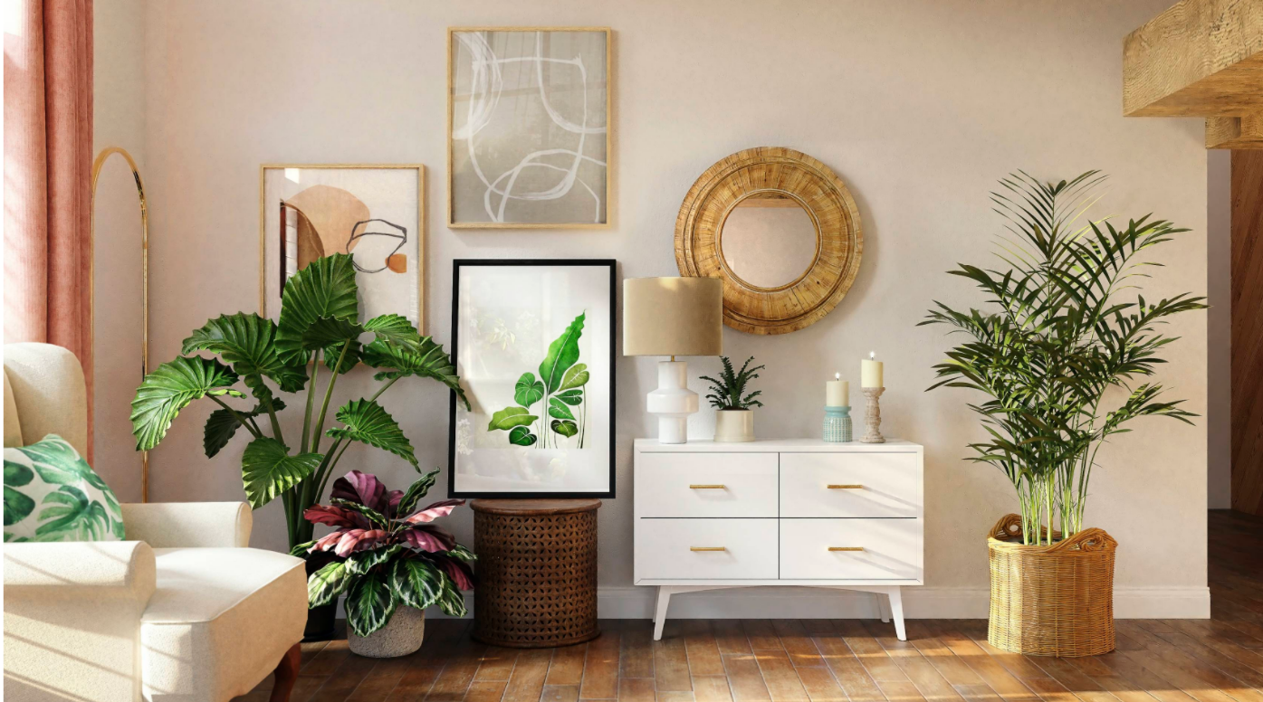
HTML PROJECT ON INTERIOR
DESIGNING
TITLE:
LUXURY
INTERIOR
DESIGNS

Slide 2

This html interior design page contains:
Content:
Home page
Design ideas
Furniture board
Budget

Slide 3
HTML
CSS
JAVA SCRIPT

Slide 4
1)This html interior design web page contains various fields like home page , Design ideas , furniture working , budget , and process or steps to how to consult . 2)If we click a Design ideas tab it will display some various home designs. 3)If we click furniture board it will display some furniture based designs for chairs , tables etc. 4)There are sub categories are there like products , in products there are living room , dining room , bed room, etc if we click any one of them it will display corresponding designs,
INTRODUCTION

Slide 5
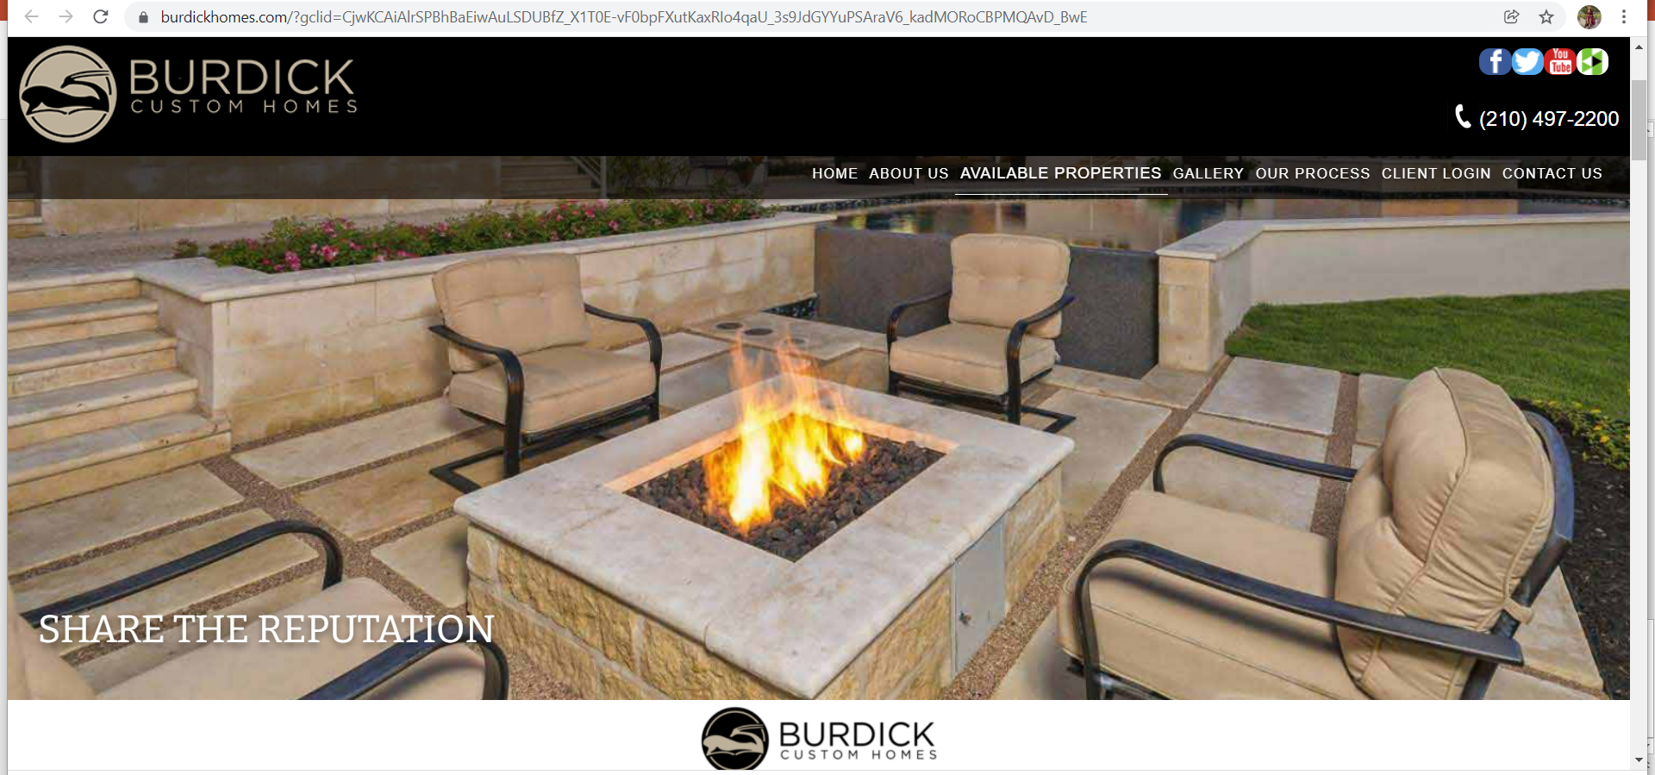

Slide 6
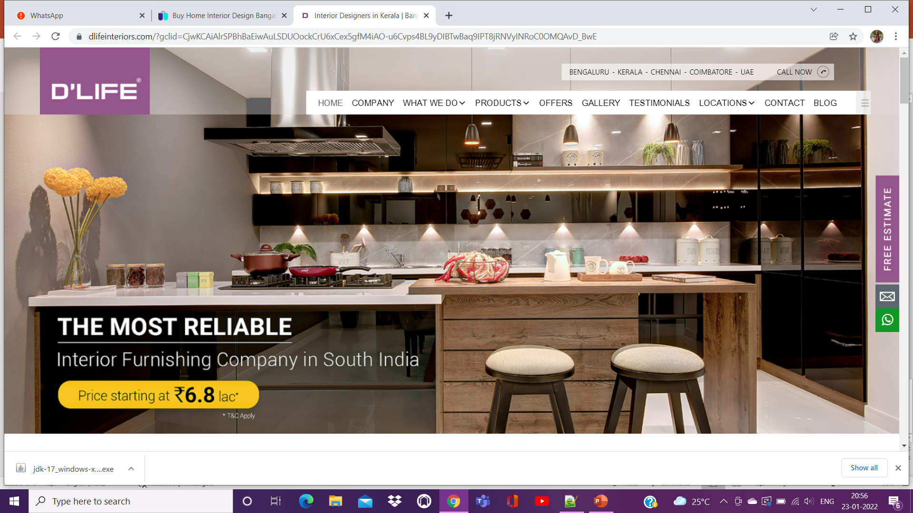

Slide 7
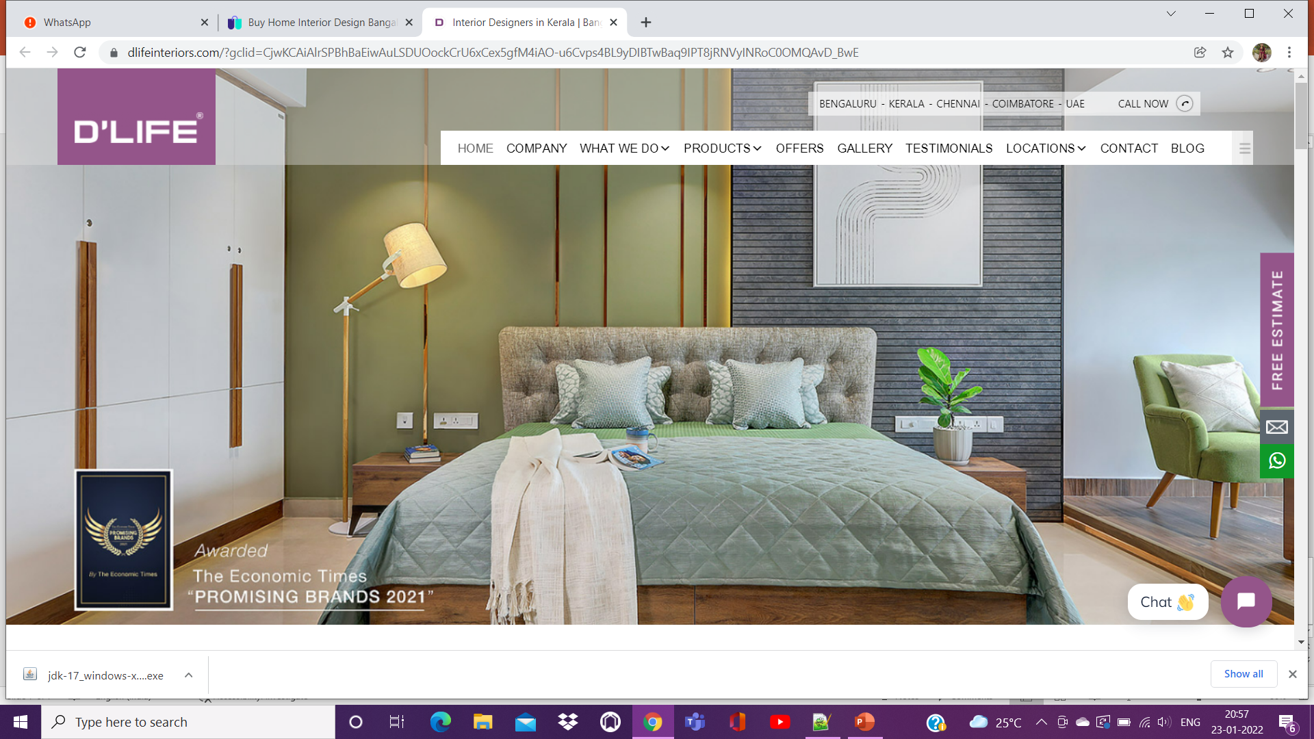

Slide 8
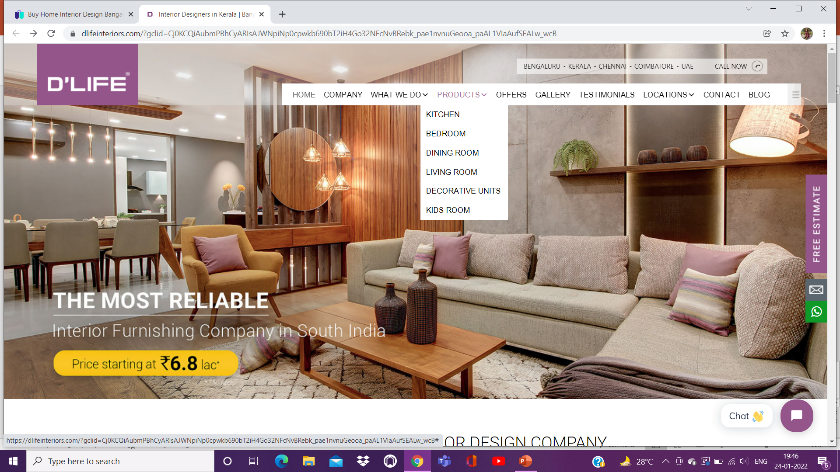



Slide 9
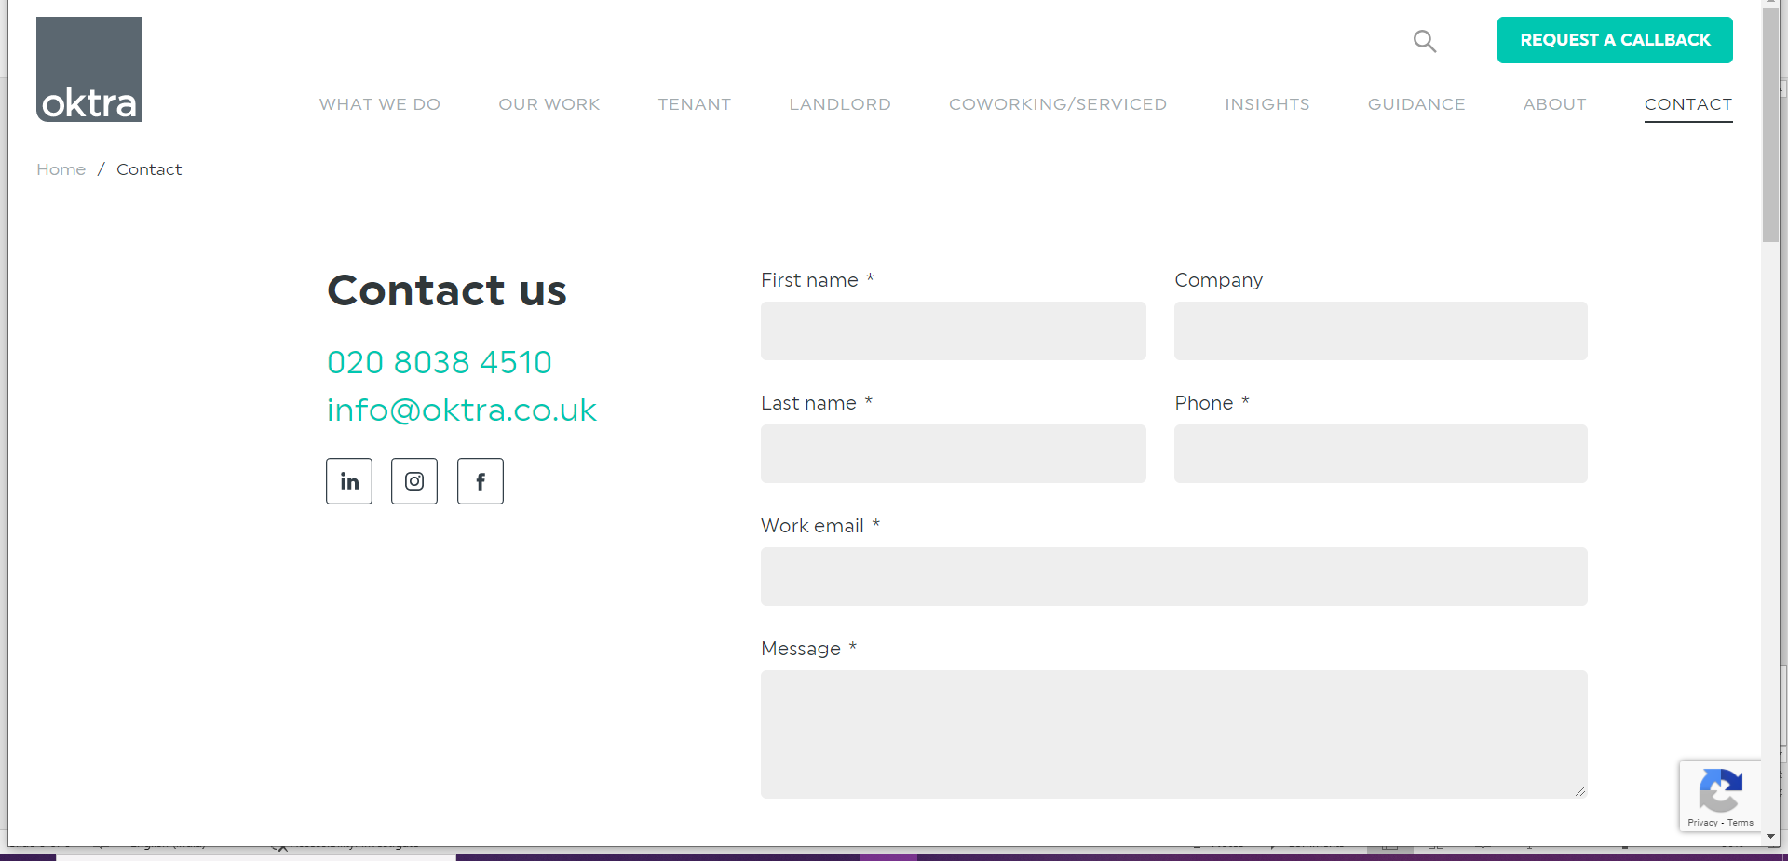
If we go to contact menu it asks some details as shown in given picture.

Slide 10
Some of the major components:
products
It displays various categories
Ex : kitchen , bedroom , living room , dinning room etc
budget
If we goes to budget it will displays budget based on the various categories.
locations
It will display various available branches in India.

Slide 11


